Slide 1
Enhanced Space Weather Monitoring System
‘SWE-X’
ESA L1/L5 Mission and Instrumentation Phase-0 Studies Overview
6.3. 2017, L5 in Tandem with L1

Slide 2





Consultants
Mark Gibbs and David Jackson
(Met Office, UK)
Yulia Bogdanova, Jackie Davies, Richard Harrison, Mario Bisi, Mike Hapgood, Chris Eyles, James Tappin and Ian Tosh
(RAL Space, STFC, UK)
Lucie Green, Bob Bentley, Andrew Fazakerley, Rob Wicks and Dhiren Kataria
(Mullard Space Science Laboratory, UCL, UK)
Jonathan Eastwood, Chris Carr, Vratislav Krupar, Helen O’Brien and Barry Whiteside
(Imperial College London, UK)
Pierre Rochus, Laurence Rossi
(Centre Spatial Liège, Be)
Acknowledgements:
Milan Maksimovic (LESIA, France),
Jan Soucek (Czech Academy of Sciences, Czech Republic)
Jasmina Magdalenic (ROB, Belgium)
Juhani Huovelin (University of Helsinki, Finland),
Sami Solanki (Max-Planck-Institut für Sonnensystemforschung, Germany)
System Study Primes (see following presentations)
OHB Systems AG, Germany supported by DEIMOS
Airbus Defence & Space (Germany, UK)

Slide 3
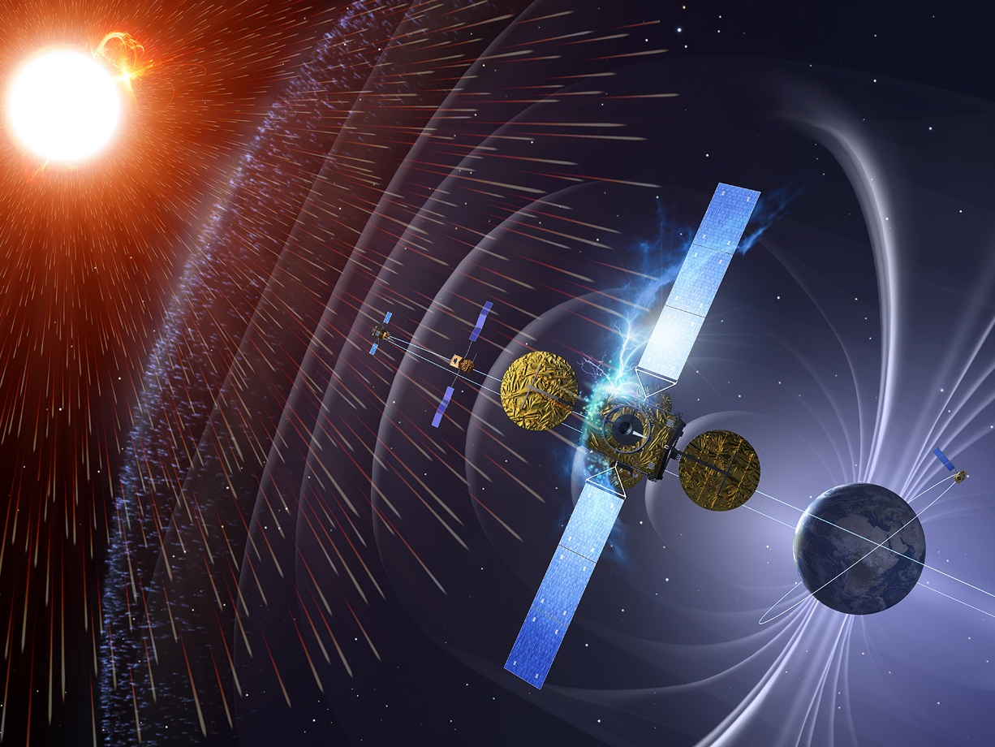
Content
L1 & L5 mission objectives
Missions observational requirements (based on CRD, SRD, and PSD)
Recommended payload and its performance – developments
(Mission architectures and preliminary designs presented by Industry)

Slide 4
L1 Mission Objectives
Primary
Geomagnetic storm forecasting with lead times of up to 12 hours
(forecast the arrival of a very fast Coronal Mass Ejections (CMEs) with ≤ 18 hour transit time) → decide on mitigation actions
  Identification of the launch of Earth directed CMEs, and their motion away from the Sun, including the prediction of arrival times at Earth
  Provision of improved inputs to heliospheric models, including estimates of the background solar wind and CME parametrisation, to improve CME arrival time and solar wind predictions at Earth
  Measurement of vector components of the Interplanetary Magnetic Field (IMF)
  Measurement of speed, density and temperature of solar wind
  Monitoring of low energy ion precursors of CME shock arrival at Earth
  Monitoring of solar energetic particles impacting the terrestrial system
  Enable real-time assessment of Earth-directed CMEs
Secondary
Monitoring of developing solar activity with potential Earth impact
Provision of stable, continuous space weather data (model development and underpinning space weather research)
Optional: NEO monitoring

Slide 5
L5 Mission Objectives
Primary
Geomagnetic storm forecasting with lead times of up to 12 hours (as for L1)
  Improvement of assessment of CME motion and density, in the corona and heliosphere, using a different observational perspective to the L1 observations
  Provision of improved inputs to heliospheric models to improve CME arrival time and solar wind predictions at Earth
  Measurement of vector components of the IMF and the speed, density and temperature in solar wind features (e.g., SIRs) rotating towards Earth.
Monitoring of active regions development up to 4-5 days beyond the East limb → identify developing solar activities with potential for Earth-impact
Enable real-time assessment of Earth-directed CMEs
Secondary
Monitoring of low energy ion signatures at L5 as indicate an Earth-directed CME shock
Provision of stable, continuous space weather data (model development and underpinning space weather research)
Enhancing: ‘To provide a broader view of solar energetic particle events occurring in the inner solar system’
Optional: NEO monitoring

Slide 6
Summary of the observational requirements (1)
ID | Product name | Observations | PSD ref. | Classification
1 | Interplanetary Magnetic-Field (IMF) | IMF magnetic-field properties and dynamics | L1-008-M | Mandatory
2 | Solar-Wind Bulk-Velocity in the IM | Solar-wind ions particle distribution | L1-009-M | Mandatory
3 | Solar-Wind Bulk-Density in the IM | Solar-wind ions particle distribution | L1-010-M | Mandatory
4 | Solar-Wind Temperature in the IM | Solar-wind ions particle distribution | L1-011-M | Mandatory
5 | High Energy >1 MeV Protons in the IM | In-situ proton fluxes | L1-001-M L1-003-M | Mandatory (L1) Enhancing (L5)
6 | Low-Energy ion flux detection in the IM | Detection of Solar-Wind Ions with E = 30keV/nuc to 1 MeV/nuc | L1-005-M | Mandatory (L1) Enhancing (L5)
7 | Photospheric Solar-Disk Magnetic-Field | Magnetic-field mapping of the photosphere | SU-005-M | Mandatory
8 | White-light wide-angle Coronagraph Images | Intensity Mapping of outer corona | SU-025-M (L1) SU-022-M (L5) | Mandatory

Slide 7
Summary of the observational requirements (2)
ID | Product name | Observations | PSD ref. | Classification
8 | White-light wide-angle Coronagraph Images | Intensity Mapping of outer corona | SU-025-M (L1) SU-022-M (L5) | Mandatory
9 | Heliospheric Images | Intensity Mapping of Heliosphere | SU-032-M | Mandatory
10 | Coronal EUV Images of the Sun | Intensity mapping of the low Corona | SU-015-M (L1) SU-021-M (L5) | Mandatory
11 | Solar X-ray flux | X-ray flux monitoring | SU-027-M | Mandatory
12 | Solar Radio-spectrographic Observations | Detection of radio burst/flare signatures and associated outward expanding shocks | SU-026-M | Enhancing
13 | Low/medium-Energy electron-flux detection in the IM | Detection of Solar-Wind Electrons with E > 30 keV to 8 MeV | L1-007-M | Mandatory (L1) Enhancing (L5)
14 | High-Energy Electron flux detection in the IM | Detection of Solar Wind Electrons with E = 2 to 50 MeV | L1-006-M | Enhancing (L1) Not Required (L5)
15 | Mid-Energy Ion-flux detection in the IM | Measurement of Solar Wind Ions with E = 1 to 10 MeV/nuc | L1-004-M | Enhancing (L1) Not required (L5)
16 | High-Energy Ion-flux detection in the IM | Detection of Solar-wind Ions E >10 MeV/nuc | L1-002-M | Enhancing (L1) Not required (L5)
10 instruments needed to cover the objectives.

Slide 8
Strawman Payload *
* Strawman Payload (baseline instruments) serve as reference to define the system and are thereby not necessarily selected for implementation.
Complete payload was studied to investigate the system constraints.

Slide 9
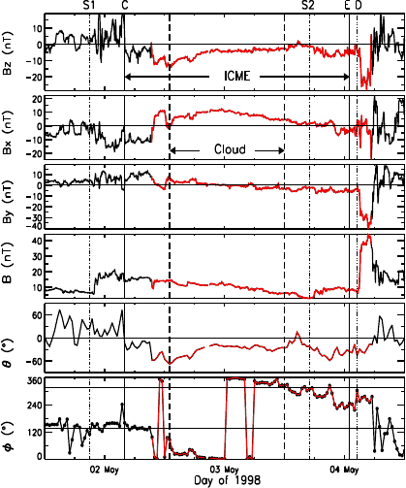
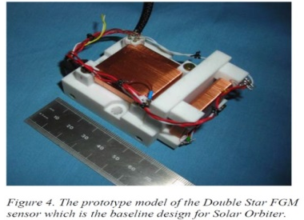
(1) Magnetometer
Measure Interplanetary Magnetic Field (IMF) Strength
  Short lead-time forecast and nowcast
  Geo-effectiveness of CMEs at L1 and Stream Interaction Regions (SIRs) at L1 and L5
Performance
  IMF vector (3-components)
  0.1 to 200 nT , Accuracy: ± 1nT (± 0.5 nT)
  Heritage
  Solar Orbiter, BepiColombo, JUICE, THOR,
  ROSETTA, VEX, Cluster, Ulysses, …
Instrument properties
  Triaxial fluxgate magnetometer
  In-board and out-board sensors
  Boom length of 5 m
No developments
  Accuracy requires appropriate magnetic cleanliness control
  Reuse are adaptation of boom for other missions
Size:
Sensor unit:
97.5 x 49 x 67 mm³
DHU:
159x162x98 mm³
Mass: 1.4 kg sensors 2.1 kg DPU + 10 kg boom
Power: 5-7 W
Telemetry:
4 bps (0.25 kbps)

Slide 10
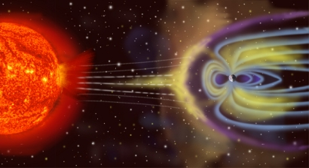
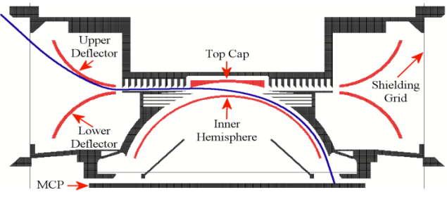
(2) Solar Wind Analyser
Measurement of Solar wind density, velocity and temperature
  Prediction and analysis of impacts of geomagnetic
  storms on magnetosphere, ionosphere and atmosphere
  Short lead-time forecast of arrival of CMRs and SIRs
Performance requirements
  Velocity range: 200 to 2500 km/s (100 to 3000 km/s)
  Density range: 0.1 to 150 cm-3 (0.1 to 200 cm⁻³)
  Temperature range: 40,000 to 1,000,000 K (10,000 – 2,000,000)
Properties
  Top-hat electrostatic analyser (segmented anodes & aperture deflection plates)
  Heritage: HIA-CIS on Cluster, SWA-PAS and SWA-EAS (Solar Orbiter)
  FoV: 45⁰ x ± 22.5⁰ (azimuthal x in the ecliptic plane elevation direction)
  Angular resolution: 5⁰ x5⁰, 9 azimuthal bins, 9 polar bins
  Energy: 70 eV/q – 32.6 keV/q (50 eV/q – 47 keV/q), 30 bins
  Dynamic range: 10⁴ - 2x10¹⁰ ions/(cm2-s-sr)
Development likely needed starting from heritage
Size:
300x300x200 mm³
Mass: 5 kg
Power: 7 W
Telemetry:
3 kbps

Slide 11
(3+4) Energetic particle instruments – L1
Enhanced configuration
  Next Generation Radiation Monitor
  (NGRM)
  Suprathermal Ion Telescope
  (SIT, STEREO)
  Low Energy Telescope
  (LET, STEREO )
  High Energy Telescope
  (HET, STEREO)
  Solar Electron Proton Telescope
  (SEPT, STEREO)
  Solar And Galactic Proton Sensors
  (SGPS, GOES-R)
Like to have instruments
Performance of these instruments are in general agreement with the observational requirements
Optimisation for Lagrange mission would be expected
Si/Ne/Ni
LET
Fe
CNO
⁴He
L1-005-M
L1-004-M
L1-002-M
³He
SIT
HET
p
L1-003-M
L1-001-M
NGRM
LET
HET
SEPT
SGPS
e-
L1-007-M
L1-006-M
NGRM
SEPT
HET
MeV/nuc
0.01
0.1
1
10
100
1000

Slide 12
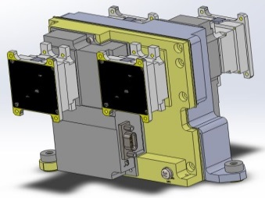
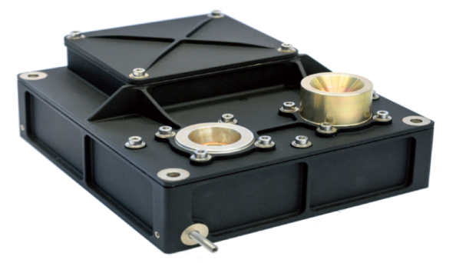
(3+4) Energetic particle instruments
Measurements objective
  Energy distribution of medium to high-energy electrons and protons
  Determine the LET of heavy ions
Covered by two instruments:
Solar Electron Proton Telescope
  Electron energies: 30-400 keV
  Proton energies: 60 keV to 7 MeV
  Two dual, double-ended magnet/foil
  solid state detector particle telescopes
  to allow particle separation
  Dual FoV, 52 deg cone
Radiation monitor
  Electrons: 100 keV to 7 MeV
  Protons: 2 MeV to 200 MeV
  Heavy Ions (Cosmic Rays and Solar Events Ions)
Size:
99 x 156 x
147 mm³
Mass: 0.8 kg
Power: 0.6 W
Telemetry:
8 bps for 5min cadence
Plus electronics
KSEM PD, GEOKOMPSAT-2A
MAVEN heritage
Size:
~1 litre
Mass: 1.4 kg
Power: 2.5 W
Telemetry:
15 (75) bps
NGRM

Slide 13
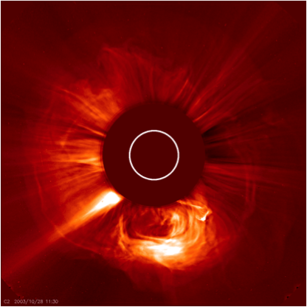
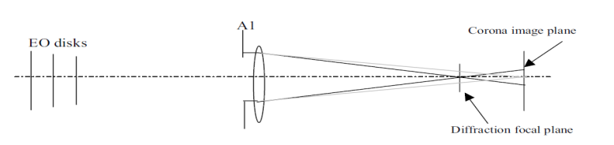
(5) Coronagraph
Measurement of Earth-directed CMEs
  Forecasting & characterisation of CME arrival at Earth
  Imagery of the near-Sun K-corona and CMEs or CME shocks therein
Performance requirements
  FoV: 3 - 22 Rs (2.5 - 30 Rs)
  Spatial resolution: 2 arcmin
  Accuracy: 20% of CME signal, SNR > 2 (>4)
  Sensitivity: detection of signal to 2 x 10⁻¹³ B_{o}
Heritage
  LASCO C2 & C3 and COR2
Instrument baseline
  Solar Coronagraph for OPErations (SCOPE)
Developments
  Current development limited to BB
  EQM or Optical Model development needed to reach TRL 6 by 2019
Size:
Sensor unit: 600x250x
250 mm³
DHU:
230x200x
80 mm³
Mass: 18 kg
Power: 25 W
Telemetry:
~10 kbps
See Middleton et al, ICSO paper 55

Slide 14
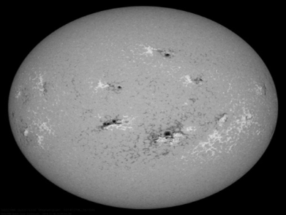
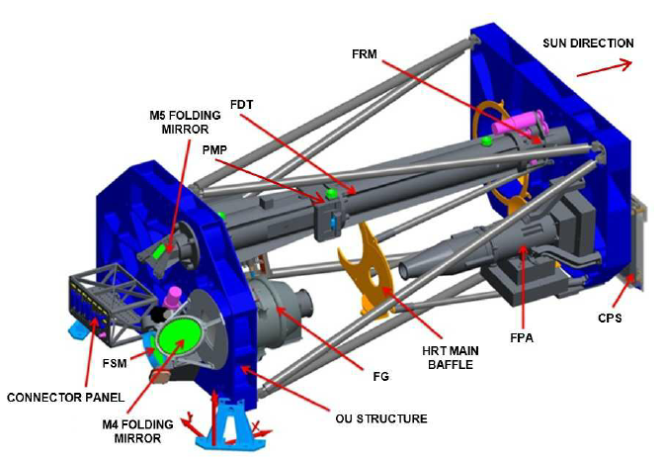
(6) Magnetograph
Measurement of Magnetic field data
  Advanced warning of developing activity, also sunspot activity, complexity and development
  Data for background solar wind modeling for arrival time prediction of CMEs at Earth
Performance requirements
  Spatial resolution: 5 (2) arcsec
  Dynamic range: ± 4 kG, 12 bits
  Line of sight magnetograph (vector magnetograph)
Heritage
  Polarimetric and Helioseismic Imager (PHI) Solar Orbiter
Instrument key functions
  Line scanning FeI @ 617.34 nm
  Polarimetric analysis
  Generation of stokes vector maps
Development
  Etalons for filtergraph (urgent) & adaptation of optics
Size:
Sensor unit: 800x200x
200 mm³
DHU:
150x80x
80 mm³
Mass: 20 kg
Power: 20 W
Telemetry:
7 (33) kbps

Slide 15
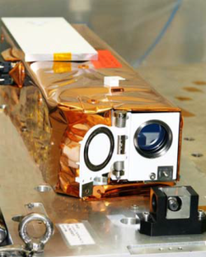
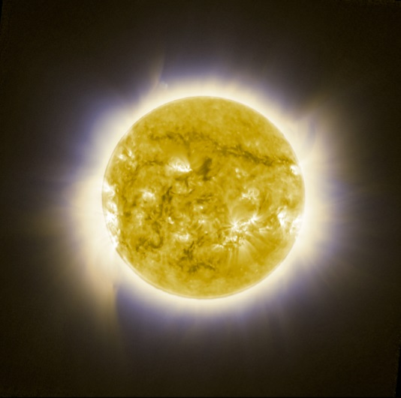
(7) EUV Imager
ESIO target resources:
Size:
Sensor unit:
260x120x120 mm³
DHU:
150x80x80 mm³
Mass: 7.5 kg
Power: 12 W
Telemetry:
L1: 24.5 kbps (78.2 kbps)
L5: 6.1 kbps (39.1 kbps)
Measurement of the chromosphere/corona
  Impending Earth-affecting solar activity (prominence eruption, coronal holes, etc.)
  Particularly on the region of the Sun that is yet to rotate to the longitude of Earth
Performance requirements
  T: Full disk image in Fe XII 193 A line
  G: also He II 304 Å, Fe IX 171 Å and Fe XIV 211 Å
  Spatial resolution: 5 (2) arcsec
Heritage
  SOHO/EIT, SDO/AIA, STEREO/EUVI, Solar Orbiter EUI, PROBA-2/SWAP
Baseline instrument
  SWAP
  Alternatives: ESIO (EUV Solar Imager for Operations) ESA dev. , EUI
Development
  Filter wheel integration or other concept for goal instrument
SWAP EUV Image – Proba 2

Slide 16
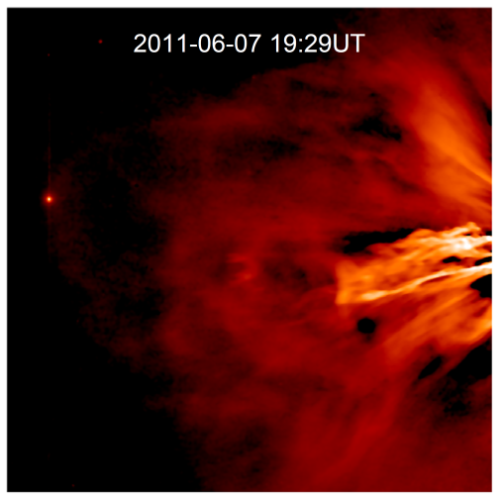
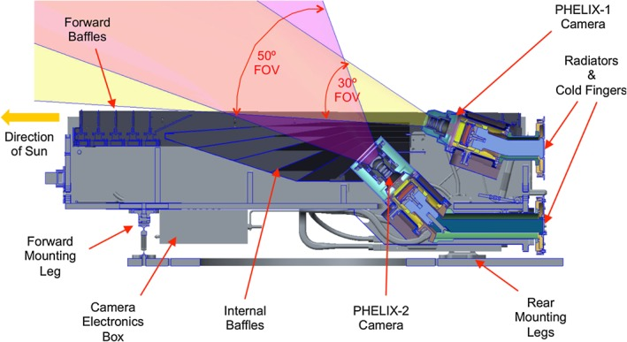
(8) Heliospheric Imager
Tracking of Earth-directed CMEs and shocks
  Mitigate deficiencies in arrival times predictions
  Provide information on the background solar wind
Performance requirements
  FoV: L1: 10 to 40 deg, L5: 10 to 60 deg (4 to 60 deg)
  Spatial resolution: 4 arcmin
  Dynamic range: ~1x10⁻¹¹ to ~3x10⁻¹³ of B₀ (G-FoV)
  Accuracy: 20% of CME signal
Heritage: STEREO HI (2 CCD based cameras)
Measurement principle
  Imaging of the solar wind broad-band visible sun light
  Low signal, high dynamic range
  L1 configuration: 2 instruments each one camera
  L5 configuration: 2 cameras within one instrument
No particular development for Lagrange missions
Size:
2 Sensor units for L1:
760x500 x230 mm³
1 Sensor unit for L5:
840 x 550 x 260
1 DHU for L1 and L5 :
250 x 150 x 60 mm³
Mass:
L1: 32 kg
L5: 20 kg
Power:
L1: 38 W
L5: 22 W
Telemetry:
L1: 42 kbps, L5: 60 kbps

Slide 17
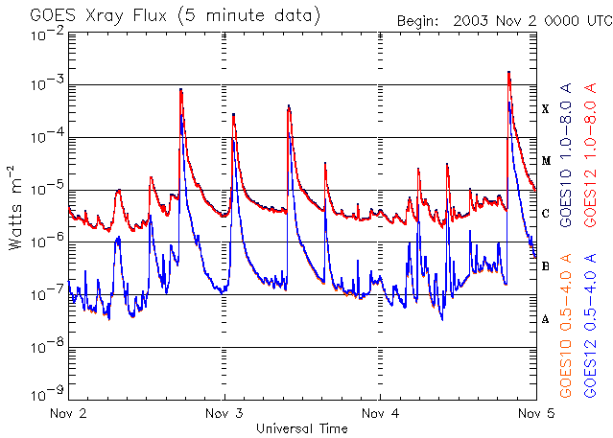
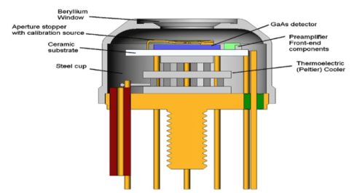
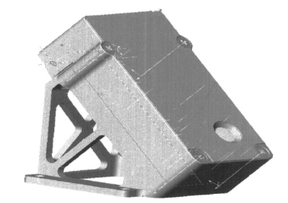
(9) X-ray flux monitor
Measurement objective
  To monitor flare activity
  Provide information to predict HF radio wave absorption in the upper atmosphere D-region
Performance requirements
  Intergrated solar X-ray flux
  Range: 1-8 Å (0.5-8 Å)
  Dynamic range: 2x10⁻⁸ to 2x10⁻³ W/m²
  Accuracy: 15%
Key characteristics
  Heritage: SMART 1 XSM, BepiColombo SIXS
  FoV: 100 deg
Development based on heritage needed
  Compact X-ray Flux Meter, ESA development
  Maximisation of benefit for L5 targeted
Size:
Sensor unit:
100x100x80 mm³
DHU:
150x80x
80 mm³
Mass: 2 kg
Power: 1 W
Telemetry:
1 (2) kbps

Slide 18
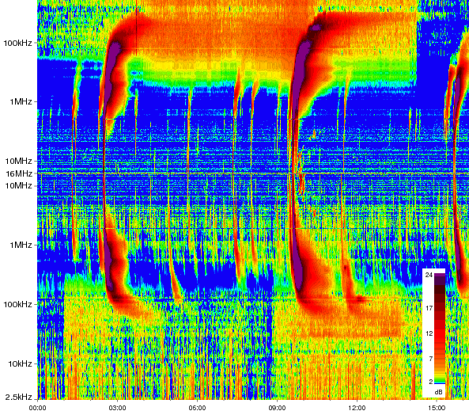
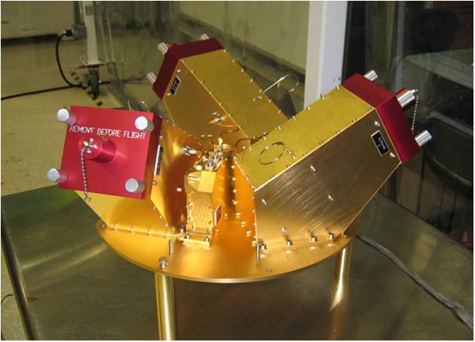
(10) Radio-burst Spectrometer
Tracking of shocks in the inner heliosphere
  Identify type of burst (Type II/IV – CME/flares)
  Determination of shock distance from the Sun and speed
Heritage: STEREO S/WAVES
  All-sky field of view, 3 antennas
Performance requirements
  Frequency range: 40 kHz - 10 MHz (10 kHz - 60 MHz)
  Dynamic range (f-dependent): 50 to 110 (120) dB
Three modified receivers to be developed (direction finding)
  Fixed Frequency Receiver (FFR) 30 or 32 MHz
  (link to ground-based measurements )
  High Frequency Receivers (HFR) ~16 MHz to ~125 kHz
  (radio noise within several solar radii to about 0.5 AU)
  Low Frequency Receiver (LFR) ~160 kHz to ~2.5 kHz
  (radio noise within 0.5 AU to 1 AU)
Size:
200 x 200 x
180 mm³
Mass: 13.25 kg
Power: 15.4 W
Telemetry:
2.5 (4) kbps
  Spectral analysis and direction finding

Slide 19
Products and related Instruments - consolidated
# | Product Name | Observation / measurement | Classification | Instrument
1 | Interplanetary Magnetic-Field (IMF) | IMF properties and dynamics | High priority | Magnetometer
2 | Solar-Wind Properties | Solar-wind velocity, bulk-density and temperature | High priority | Plasma Analyser
3 | Photospheric Solar Disk Magnetic Field | Magnetic-field mapping of the photosphere | High priority | Magnetograph
4 | White-light wide-angle Coronagraph Images | Intensity Mapping of outer corona | High priority | Coronagraph
5 | Coronal EUV Images of the Sun | Intensity mapping of the low Corona | High priority | EUV imager
6 | Heliospheric Images | Intensity Mapping of Heliosphere | High priority | Heliospheric Imager
7 | Solar X-ray flux | X-ray flux monitoring | High priority | X-ray monitor
8 | High Energy Protons | Energy distribution and flux dynamics with E>10 MeV | High priority (L1) Enhancing (L5) | Radiation monitor
9 | Medium-Energy ions | Detection of Solar-Wind Ions with E = 30keV/nuc to 1 MeV/nuc | High priority (L1) Enhancing (L5) | Medium Energy Particle Spectrometer
10 | Medium-Energy electrons | Solar-Wind Electron flux and energy distribution with E = 30 keV to 8 MeV | High priority (L1) Enhancing (L5) | Medium Energy Particle Spectrometer
11 | Solar radio-spectrographic emissions | Detection of radio burst/flare signatures and associated outward expanding shocks | Enhancing | Radio burst spectrograph
12 | Medium-Energy Ions | Solar-Wind Ion flux and energy distribution with E = 1 to 10 MeV/nuc | Enhancing | Medium Energy Particle Spectrometer
13 | High-Energy Ions | Solar-Wind Ion flux and energy distribution with E >10 MeV/nuc | Enhancing | Radiation monitor
SSA Workplan
Considered for GSTP
Not part of baseline

Slide 20


THANK YOU
swe.ssa.esa.int
www.esa.int

